Slide 1
Project
Investor and Investment Analysis
Description:-
The Investors and Investment Analysis project leverages SQL to manage, analyze, and visualize financial data pertaining to various investments and investor portfolios. This project aims to provide actionable insights to investors by querying and interpreting large datasets, facilitating informed decision-making in investment strategies.

Slide 2
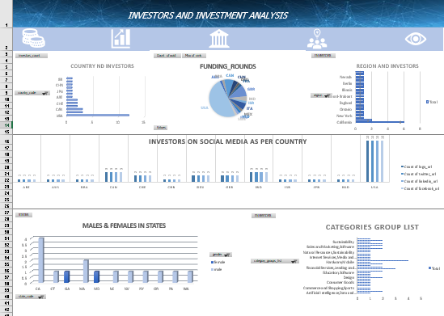
Overview:

Slide 3
Insights Include :
From which countries most investors are from?
How many investors have investment partners?
Type of funding round investors are investing in?
Distribution of investors between Organization and individual person
Regional Analysis of investors
Analysis of social media presence of investors
Qualification (Degree) and Institution Analysis of investors

Slide 4
Insight 1 : Investors in different country

Slide 5
Insight 2 :Investors in regions

Slide 6
Insight 3:Investors in social media platforms

Slide 7
Insight 4:Investors with there ranks

Slide 8
Insight 5:males and females in states

Slide 9
Insight 6:category grouping of investors

Slide 10
THANK YOU

